Slide 1
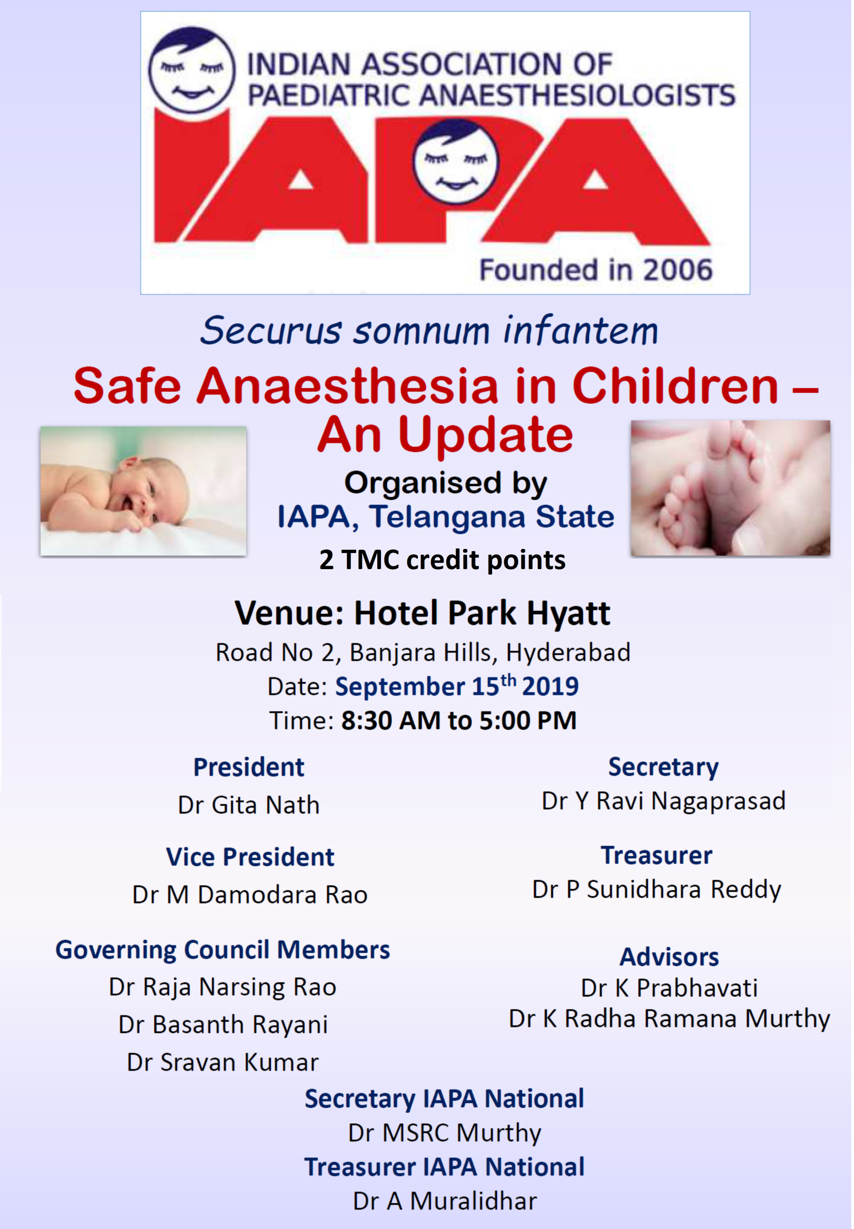

Slide 2
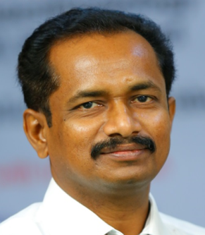
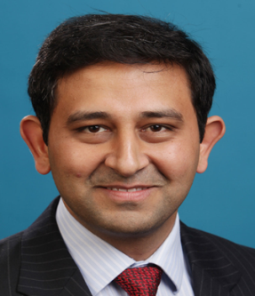
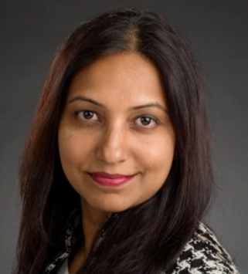
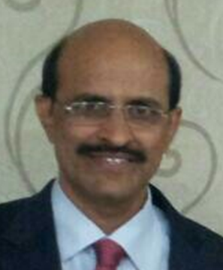
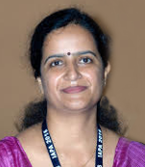
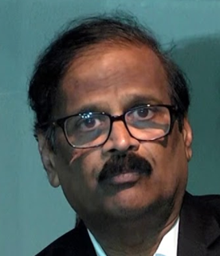
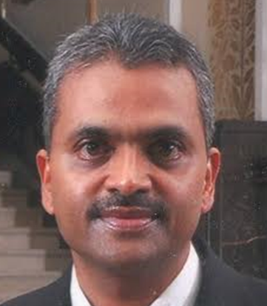
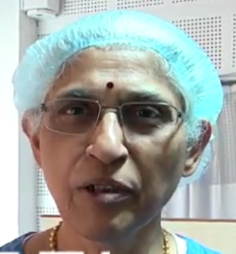
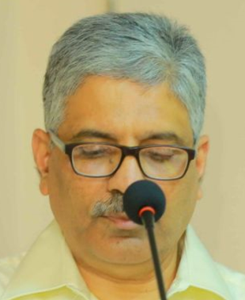
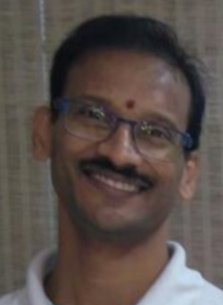
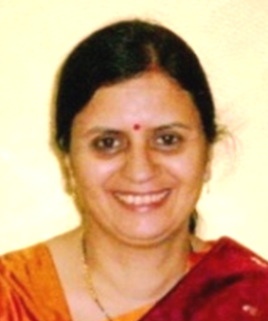
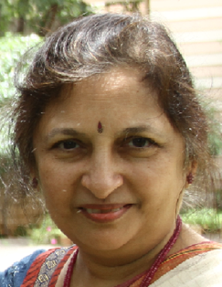
It is almost a year since the Telangana branch of IAPA was formed, on the 26th August 2018. During this time, the state body has been very active academically, with the SAFE Paediatric course in October 2018, the FAST program for postgraduates in November 2018, Neonatal resuscitation workshops for paramedical and nursing staff, and of course the regular clinical meets of the society!
We invite you all to join us to mark this occasion by attending a 1-day CME focusing on different aspects of safe anaesthesia in paediatrics. We have the privilege of having as faculty, renowned experts in patient safety and quality improvement from abroad and reputed teachers in paediatric anaesthesia from Hyderabad as well as other parts of the country.
Dr A Muralidhar
Hyderabad
Dr Rajeev Subramanian
Philadelphia, US
Dr Kavitha Raghavan
Memphis, US
Dr MSRC Murthy
Hyderabad
Dr Ekta Rai
Vellore
Dr Rajanarasimha Rao
Hyderabad
Dr M Subrahmanyam
Hyderabad
Dr K Prabhavati
Hyderabad
Dr Ravi Nagaprasad
Hyderabad
Dr Sanjay Prabhu
Chennai
Dr Indu Sen
Chandigarh
Dr Gita Nath
Hyderabad

Slide 3
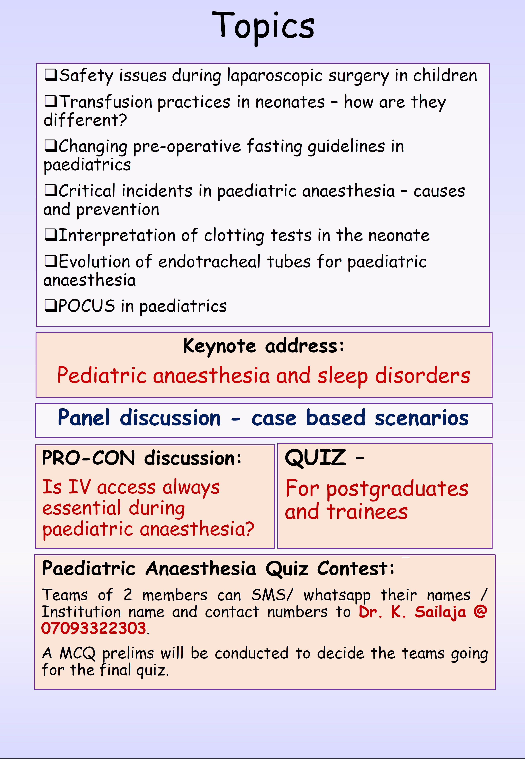

Slide 4
